Slide 1
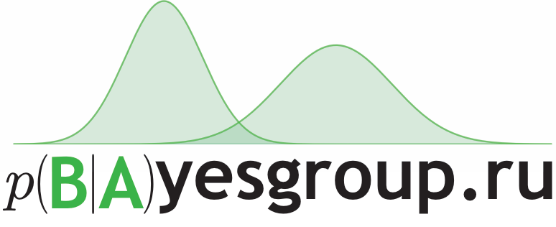


Variance Networks
When Expectation Does Not Meet Your Expectations
Dmitry Molchanov
May 11, 2018
https://arxiv.org/abs/1803.03764

Slide 2
Stochastic Neural Networks
Dropout
Batch Normalization
Bayesian Neural Networks
Train time:
Inject noise
Test time:
Mean propagation
Ensembling
Distillation / fast dropout / …

Slide 3
Is noise informative?
Dropout: 1 dropout rate per layer, no information in the noise
FFG posterior
Small variance
Learns weight “uncertainty”; we can permute variances with almost no accuracy drop
More complex posteriors?
Multiplicative normalizing flows? Maybe…
Can we explicitly learn informative noise for better ensembling?

Slide 4
Outline
Variance networks
Variational dropout ⬄ variance network
Mean propagation
Open questions

Slide 5
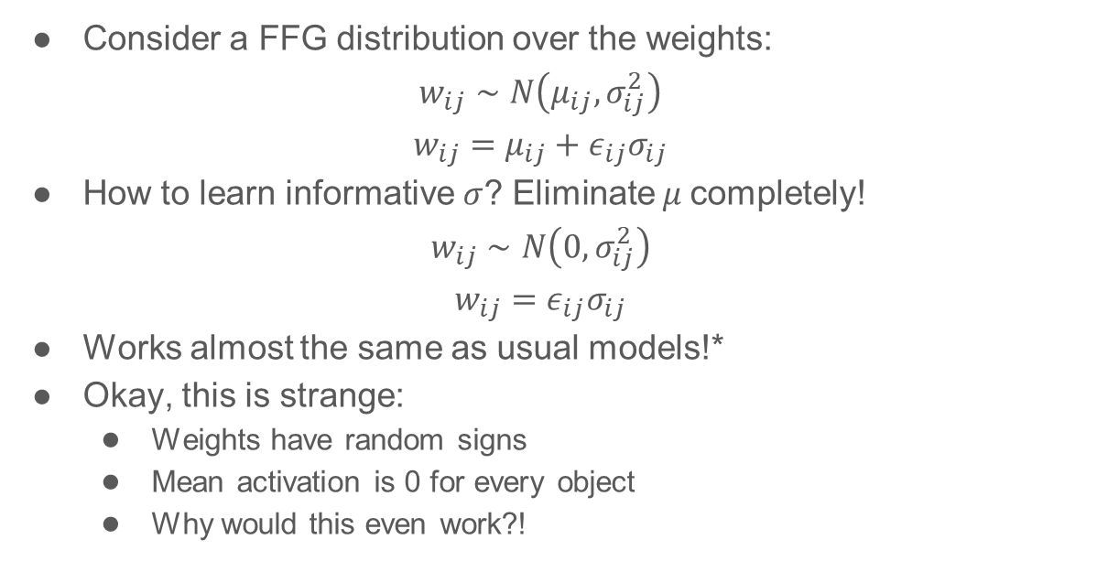
Variance networks
Consider a FFG distribution over the weights:
$$w_{ij}∼N\left(μ_{ij}, σ_{ij}^{2}\right)$$
$$w_{ij}=μ_{ij}+ε_{ij}σ_{ij}$$
How to learn informative $σ$? Eliminate $μ$completely!
$$w_{ij}∼N\left(0, σ_{ij}^{2}\right)$$
$$w_{ij}=ε_{ij}σ_{ij}$$
Works almost the same as usual models!*
Okay, this is strange:
Weights have random signs
Mean activation is 0 for every object
Why would this even work?!
* Conditions apply

Slide 6
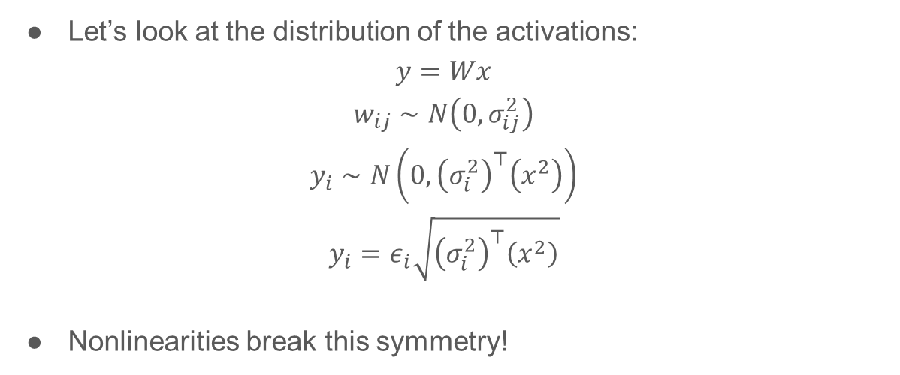
Variance networks demystified
Let’s look at the distribution of the activations:
$$y=Wx$$
$$w_{ij}∼N\left(0, σ_{ij}^{2}\right)$$
$$y_{i}∼N\left(0, {\left(σ_{i}^{2}\right)}^{⊤}\left(x^{2}\right)\right)$$
$$y_{i}=ε_{i}\sqrt{{\left(σ_{i}^{2}\right)}^{⊤}\left(x^{2}\right)}$$
Nonlinearities break this symmetry!
(a.k.a. the local
reparameterization trick)

Slide 7
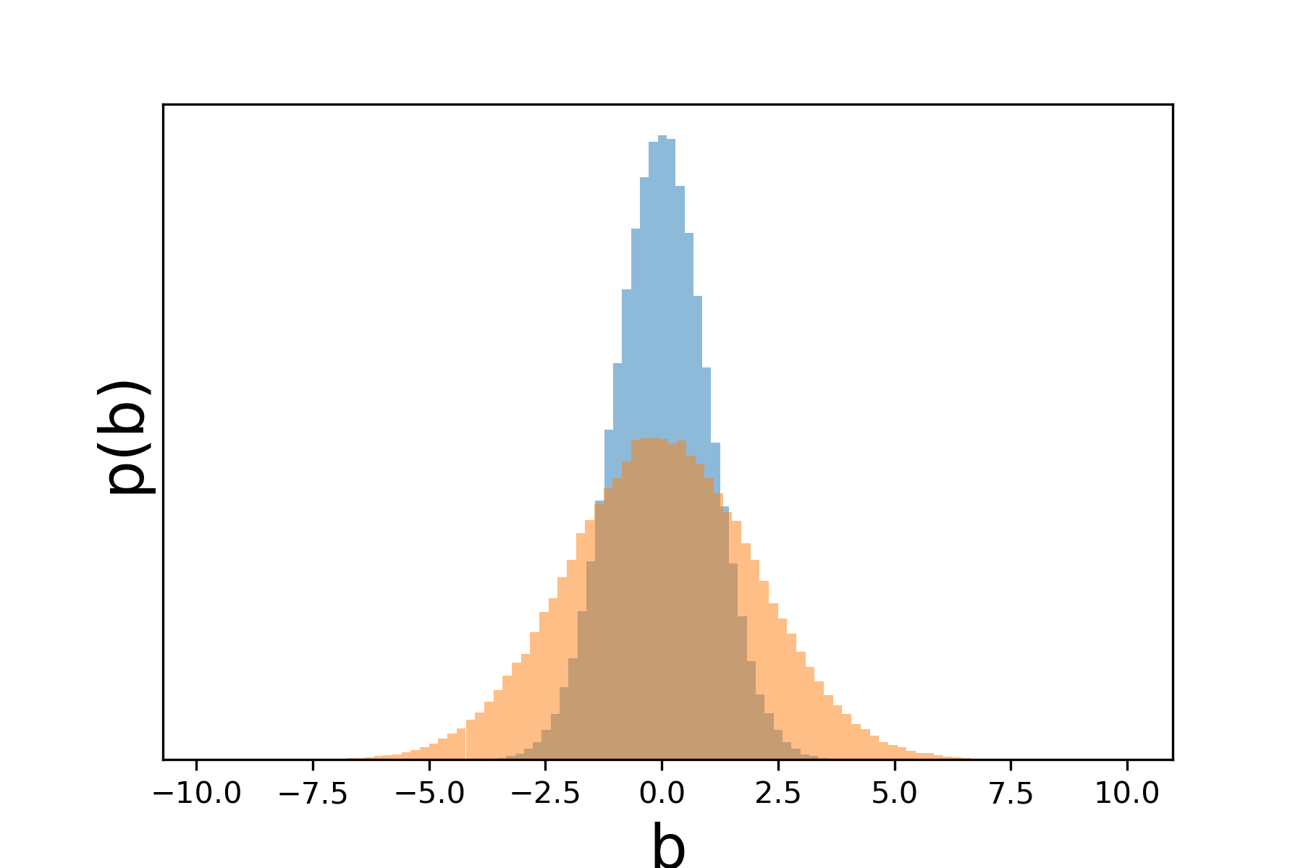
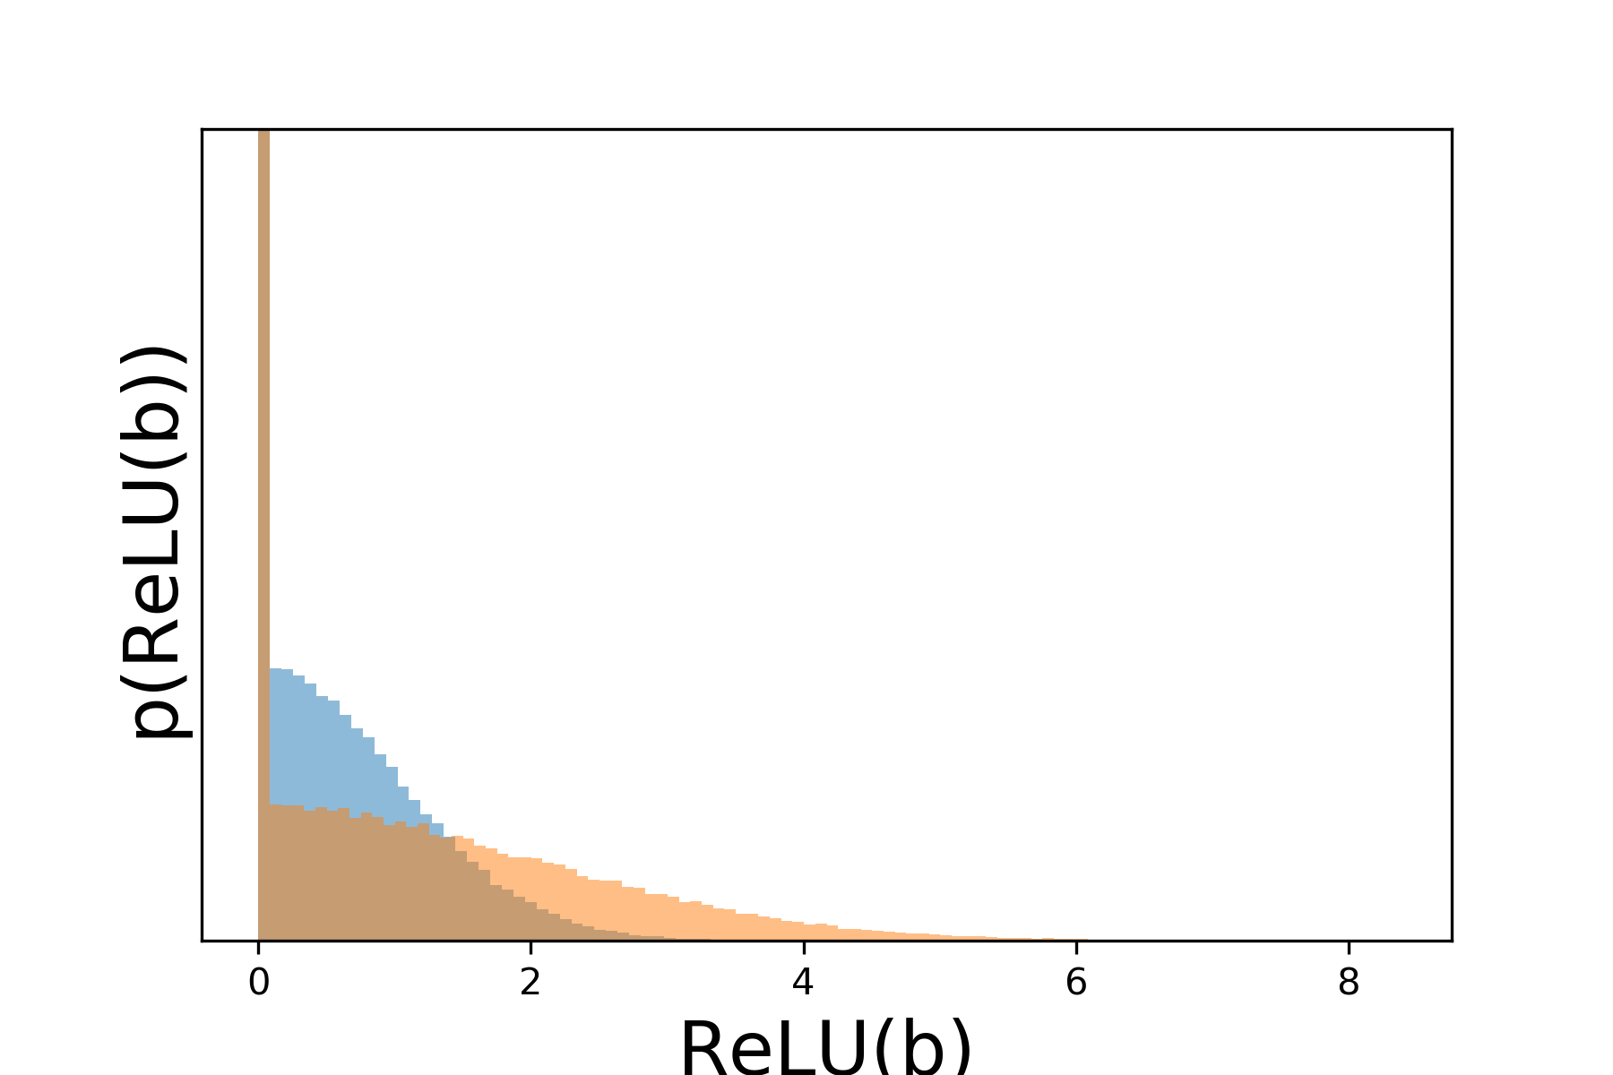

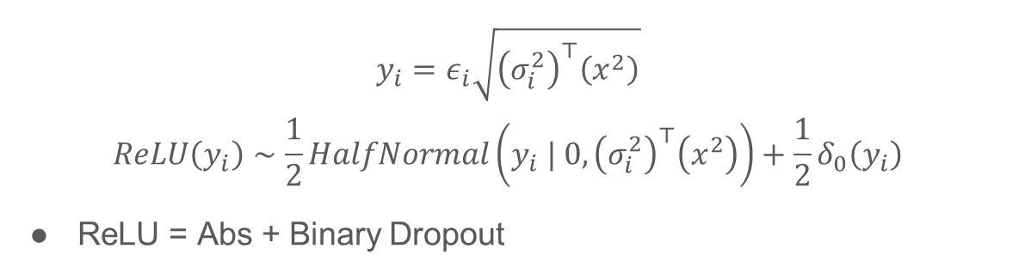



Variance networks demystified
ReLU
$$p(y)$$
$$p(ReLU(y))$$
$$y$$
$$ReLU(y)$$
$$y_{i}=ε_{i}\sqrt{{\left(σ_{i}^{2}\right)}^{⊤}\left(x^{2}\right)}$$
$$ReLU\left(y_{i}\right)∼\frac{1}{2}HalfNormal\left(y_{i} | 0,{\left(σ_{i}^{2}\right)}^{⊤}\left(x^{2}\right)\right)+\frac{1}{2}δ_{0}\left(y_{i}\right)$$
ReLU = Abs + Binary Dropout

Slide 8
Variance networks demystified
ReLU
$$p(y)$$
$$p(ReLU(y))$$
$$y$$
$$ReLU(y)$$
Nonlinearity breaks the symmetry
The information is stored in the magnitude of the activations
Biases add some more expressivity

Slide 9
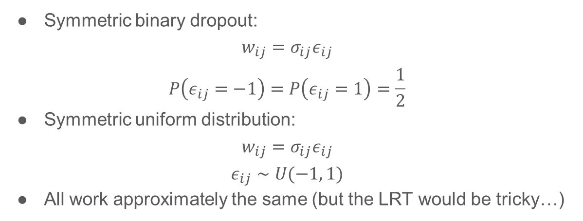
Would other symmetric distributions work?
Symmetric binary dropout:
$$w_{ij}=σ_{ij}ε_{ij}$$
$$P\left(ε_{ij}=−1\right)=P\left(ε_{ij}=1\right)=\frac{1}{2}$$
Symmetric uniform distribution:
$$w_{ij}=σ_{ij}ε_{ij}$$
$$ε_{ij}∼U(−1, 1)$$
All work approximately the same (but the LRT would be tricky…)

Slide 10
Outline
Variance networks
Variational dropout ⬄ variance network
Mean propagation
Open questions

Slide 11
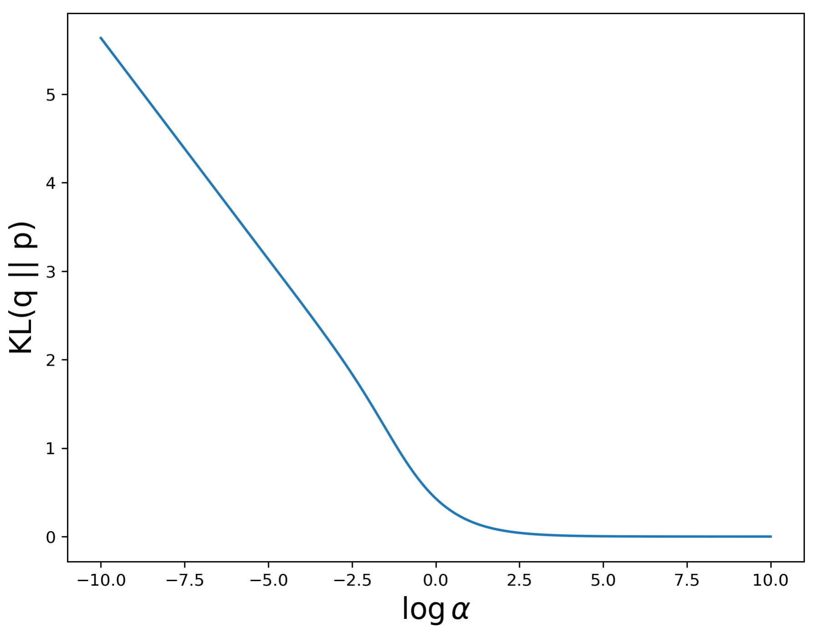
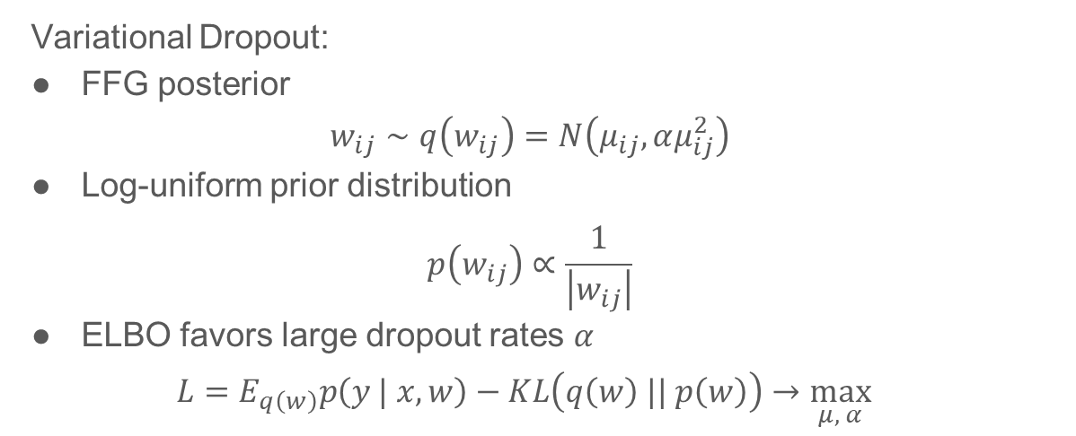
Variational dropout is a variance network
Variational Dropout:
FFG posterior
$$w_{ij}∼q\left(w_{ij}\right)=N\left(μ_{ij}, αμ_{ij}^{2}\right)$$
Log-uniform prior distribution
$$p\left(w_{ij}\right)∝\frac{1}{\left|w_{ij}\right|}$$
ELBO favors large dropout rates $α$
$$L=E_{q\left(w\right)}p\left(y | x,w\right)−KL\left(q\left(w\right) || p\left(w\right)\right)→\max_{μ, α}{ }$$

Slide 12
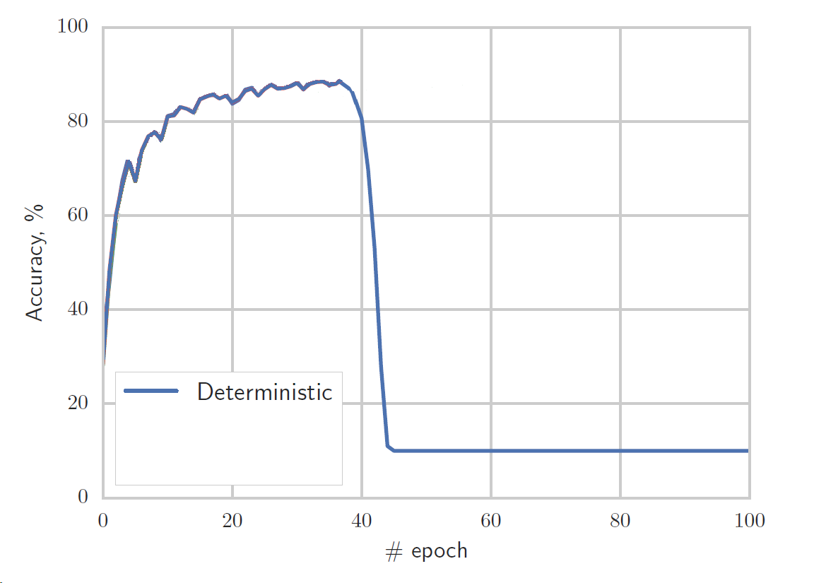
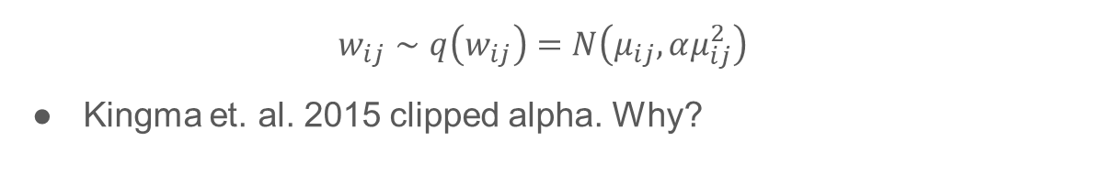
Variational dropout is a variance network
$$w_{ij}∼q\left(w_{ij}\right)=N\left(μ_{ij}, αμ_{ij}^{2}\right)$$
Kingma et. al. 2015 clipped alpha. Why?

Slide 13
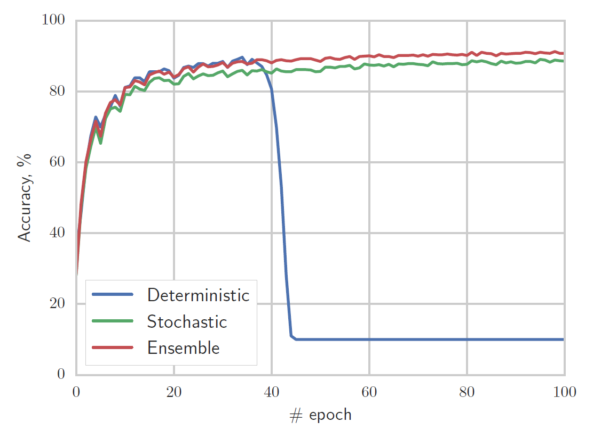

Variational dropout is a variance network
$$α>{10}^{5}$$

Slide 14
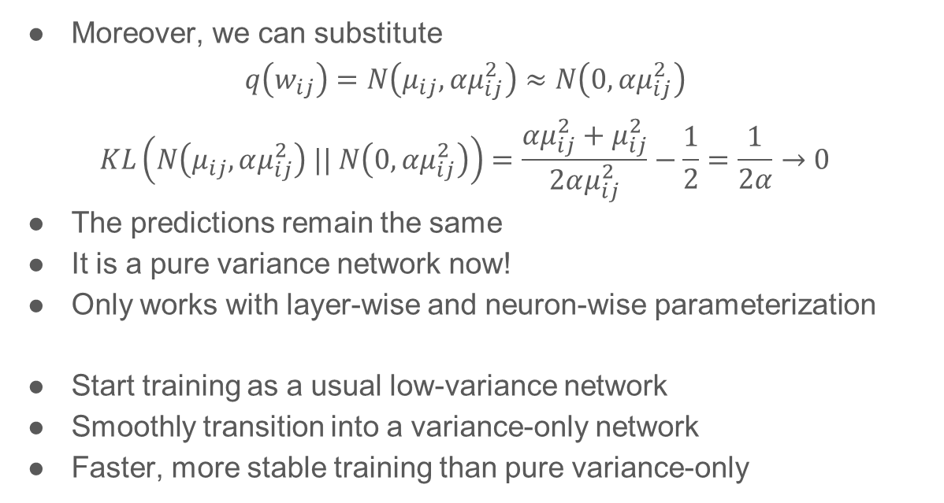
Variational dropout is a variance network
Moreover, we can substitute
$$q\left(w_{ij}\right)=N\left(μ_{ij}, αμ_{ij}^{2}\right)≈N\left(0, αμ_{ij}^{2}\right)$$
$$KL\left(N\left(μ_{ij}, αμ_{ij}^{2}\right) || N\left(0, αμ_{ij}^{2}\right)\right)=\frac{αμ_{ij}^{2}+μ_{ij}^{2}}{2αμ_{ij}^{2}}−\frac{1}{2}=\frac{1}{2α}→0$$
The predictions remain the same
It is a pure variance network now!
Only works with layer-wise and neuron-wise parameterization
Start training as a usual low-variance network
Smoothly transition into a variance-only network
Faster, more stable training than pure variance-only

Slide 15
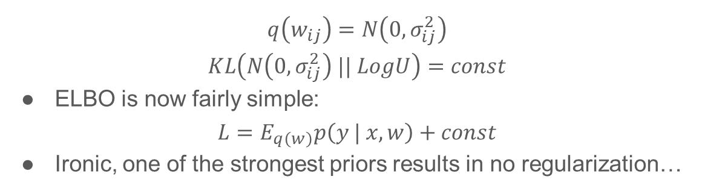
Variance network is variational dropout
$$q\left(w_{ij}\right)=N\left(0, σ_{ij}^{2}\right)$$
$$KL\left(N\left(0, σ_{ij}^{2}\right) || LogU\right)=const$$
ELBO is now fairly simple:
$$L=E_{q\left(w\right)}p\left(y | x,w\right)+const$$
Ironic, one of the strongest priors results in no regularization…

Slide 16
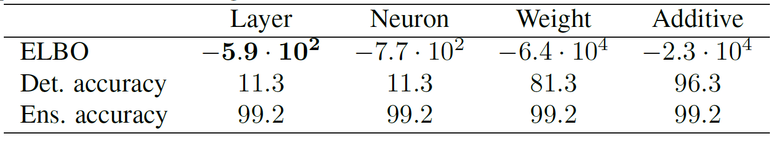
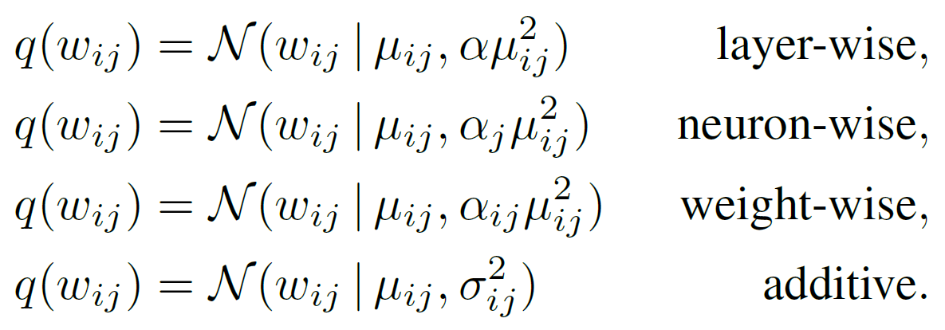
Variational dropout is a varaince network
Variance network is actually the best possible variational dropout network!
Sparse Variational Dropout is just a poor local optimum ☹

Slide 17
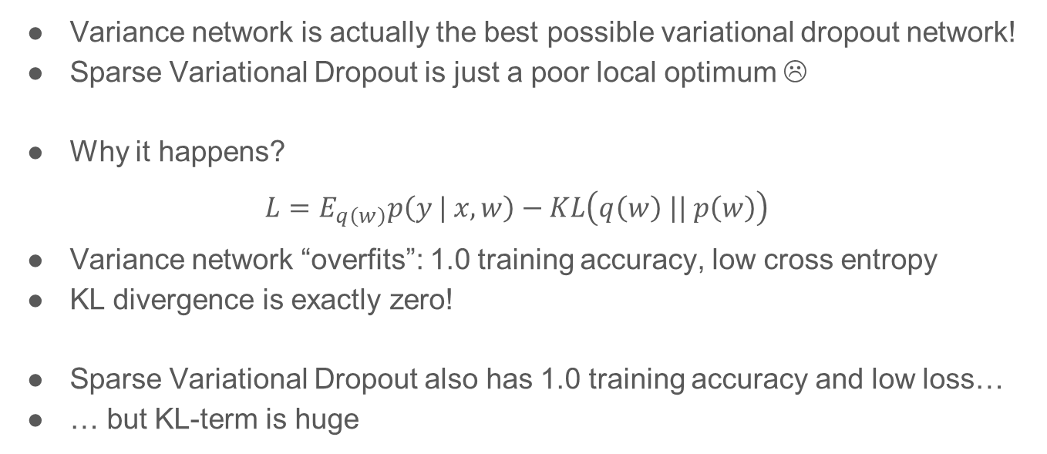
Variational dropout is a varaince network
Variance network is actually the best possible variational dropout network!
Sparse Variational Dropout is just a poor local optimum ☹
Why it happens?
$$L=E_{q\left(w\right)}p\left(y | x,w\right)−KL\left(q\left(w\right) || p\left(w\right)\right)$$
Variance network “overfits”: 1.0 training accuracy, low cross entropy
KL divergence is exactly zero!
Sparse Variational Dropout also has 1.0 training accuracy and low loss…
… but KL-term is huge

Slide 18
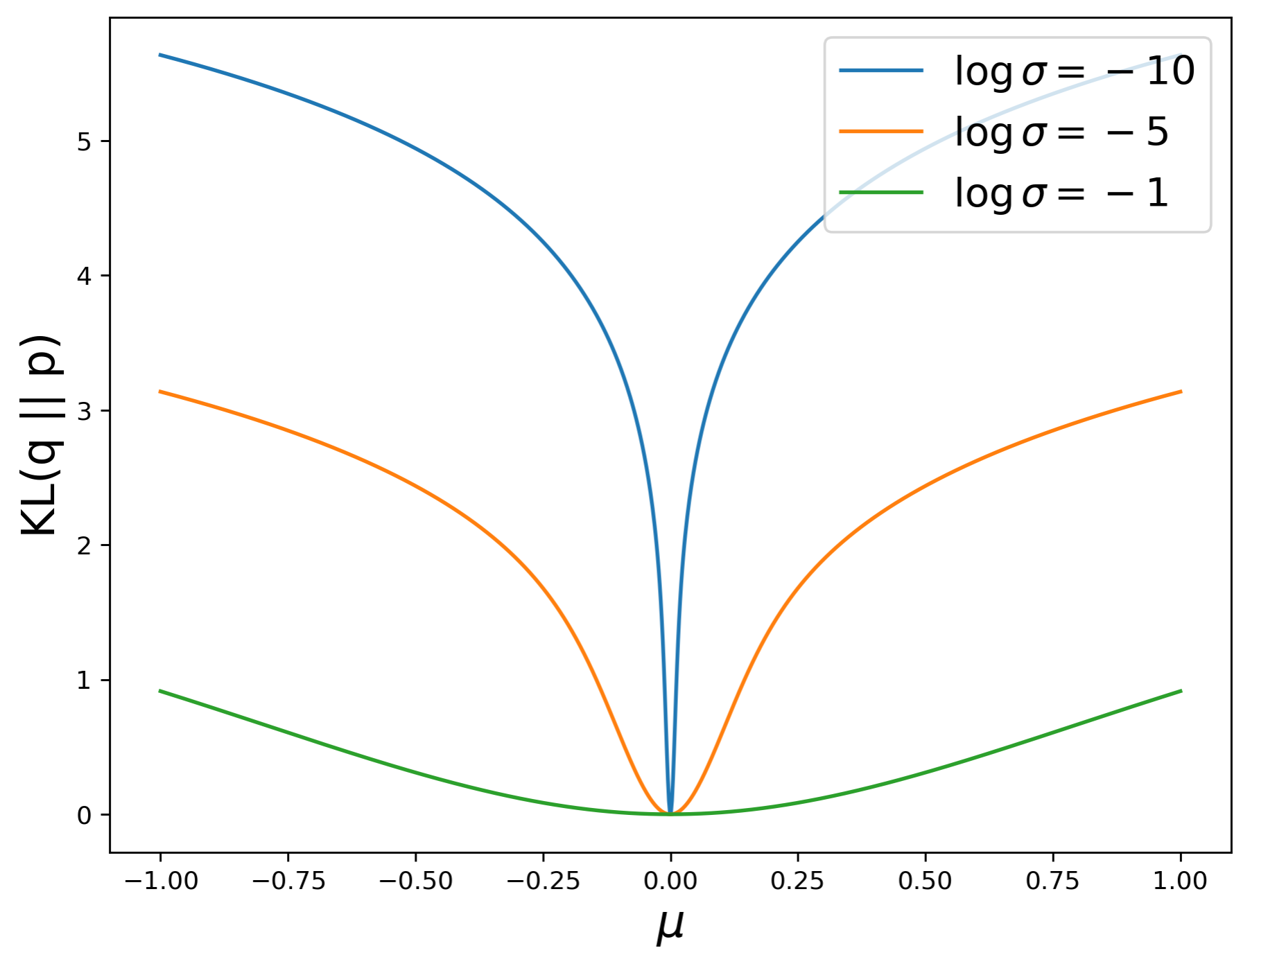
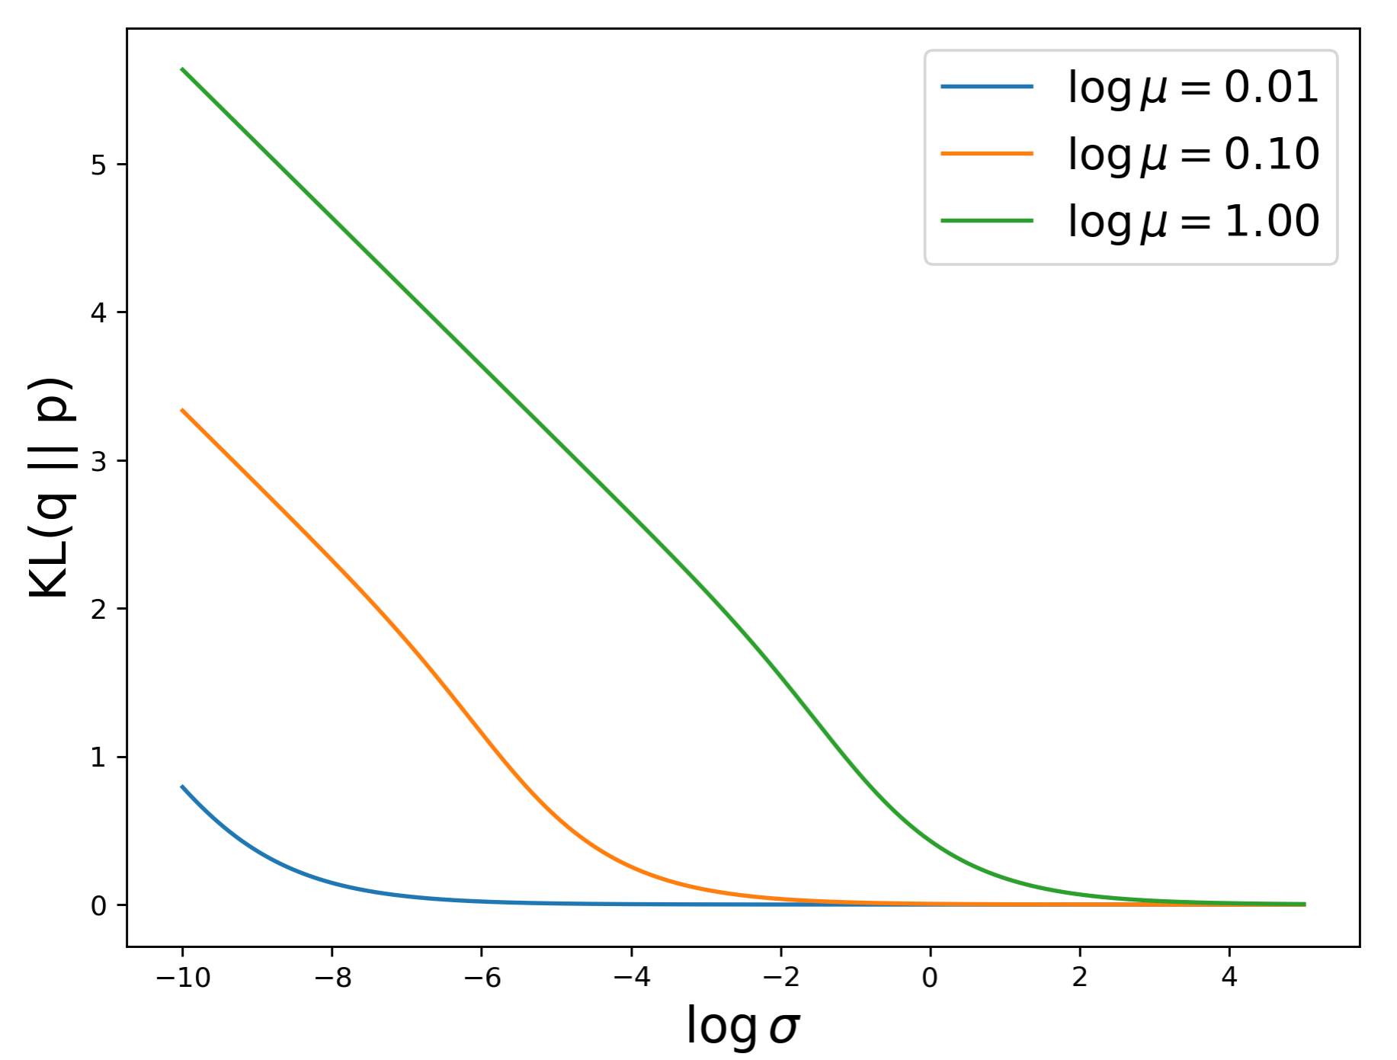
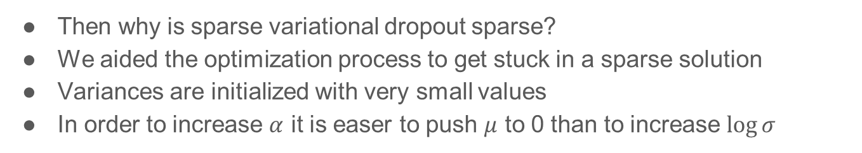
Sparsity in sparse variational dropout
Then why is sparse variational dropout sparse?
We aided the optimization process to get stuck in a sparse solution
Variances are initialized with very small values
In order to increase $α$ it is easer to push $μ$ to 0 than to increase $\log{σ}$

Slide 19
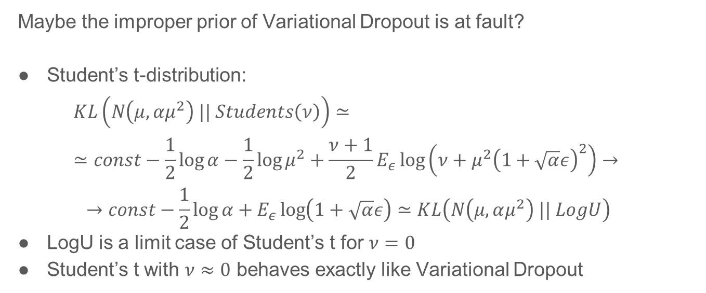
Do other models lead to variance networks?
Maybe the improper prior of Variational Dropout is at fault?
Student’s t-distribution:
$$KL\left(N\left(μ, αμ^{2}\right) || Students\left(ν\right)\right)≃≃const−\frac{1}{2}\log{α}−\frac{1}{2}\log{μ^{2}}+\frac{ν+1}{2}E_{ε}\log\left(ν+{μ^{2}\left(1+\sqrt{α}ε\right)}^{2}\right)→$$
$$→const−\frac{1}{2}\log{α}+E_{ε}\log\left(1+\sqrt{α}ε\right)≃KL\left(N\left(μ,αμ^{2}\right) || LogU\right)$$
LogU is a limit case of Student’s t for $ν=0$
Student’s t with $ν≈0$ behaves exactly like Variational Dropout

Slide 20
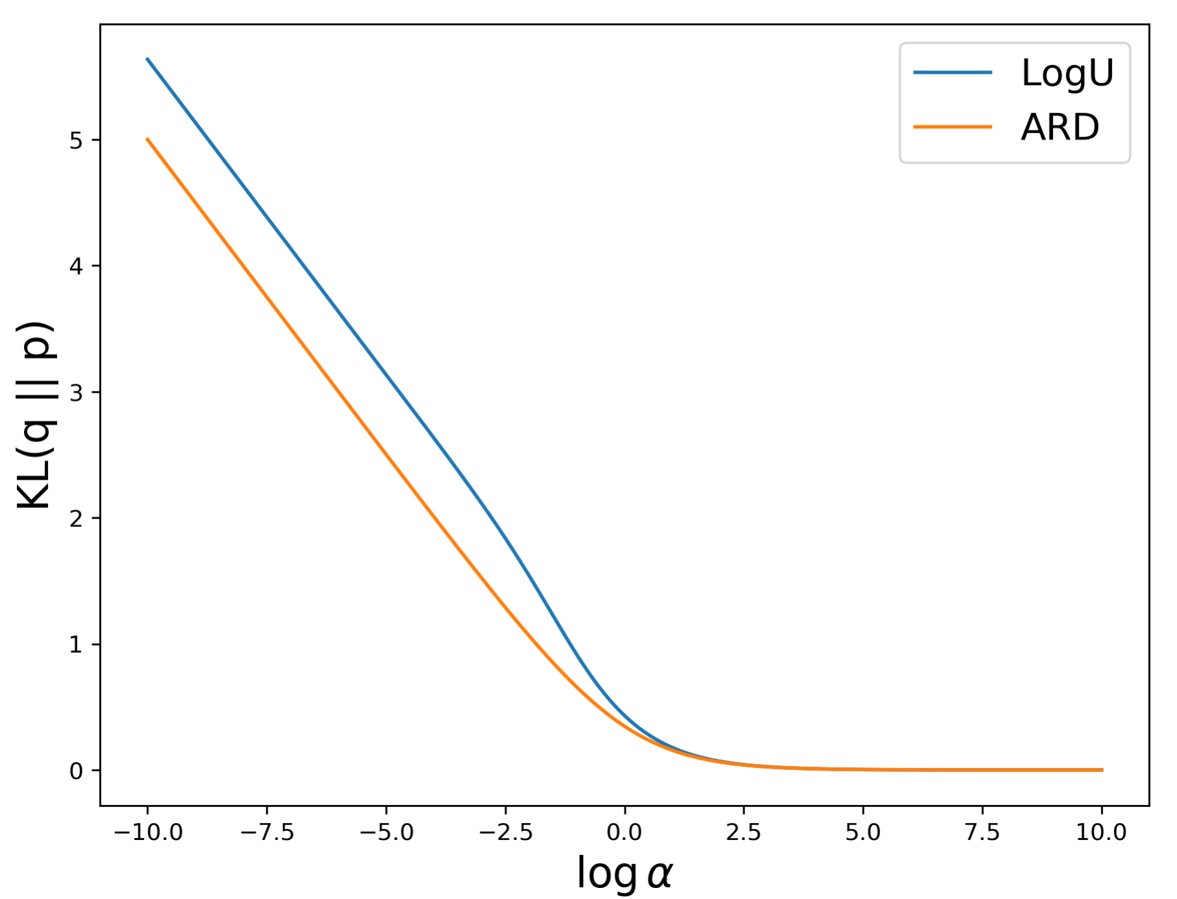

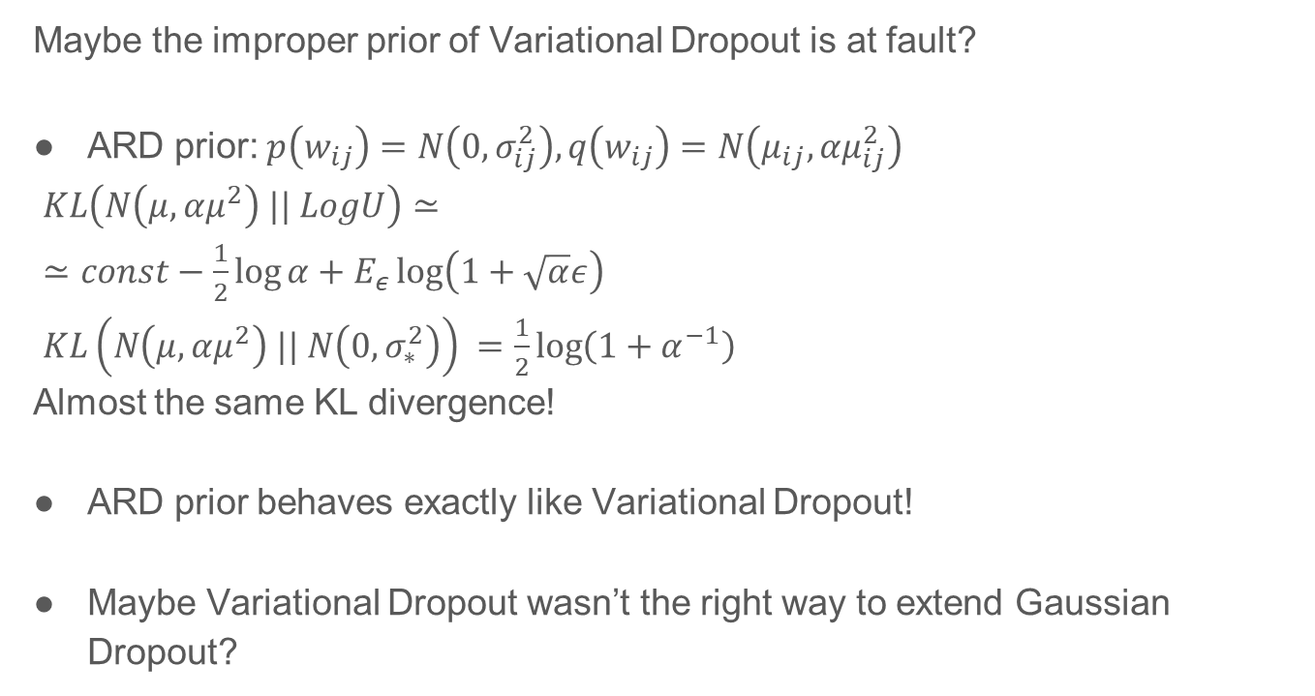
Do other models lead to variance networks?
Maybe the improper prior of Variational Dropout is at fault?
ARD prior: $p\left(w_{ij}\right)=N\left(0, σ_{ij}^{2}\right), q\left(w_{ij}\right)=N\left(μ_{ij}, αμ_{ij}^{2}\right)$
$KL\left(N\left(μ,αμ^{2}\right) || LogU\right)≃$
$≃const−\frac{1}{2}\log{α}+E_{ε}\log\left(1+\sqrt{α}ε\right)$
$KL\left(N\left(μ,αμ^{2}\right) || N\left(0, σ_{∗}^{2}\right)\right) =\frac{1}{2}\log\left(1+α^{−1}\right)$
Almost the same KL divergence!
ARD prior behaves exactly like Variational Dropout!
Maybe Variational Dropout wasn’t the right way to extend Gaussian Dropout?

Slide 21
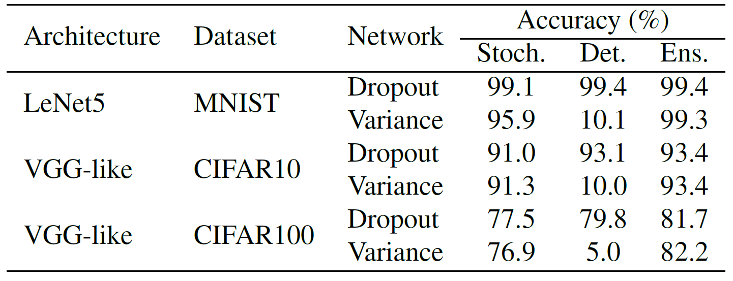
Experiments: classification

Slide 22
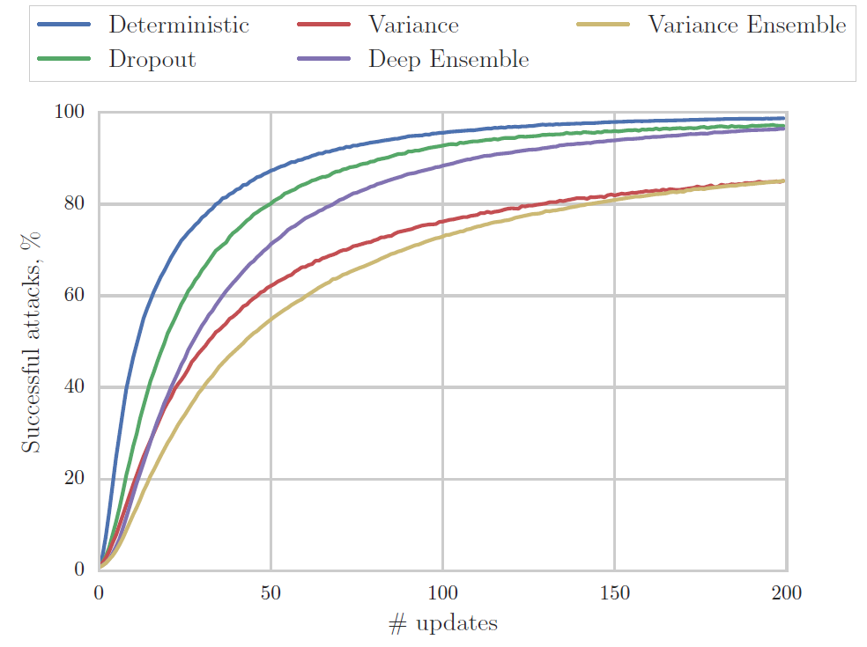
Experiments: adversarial attacks

Slide 23
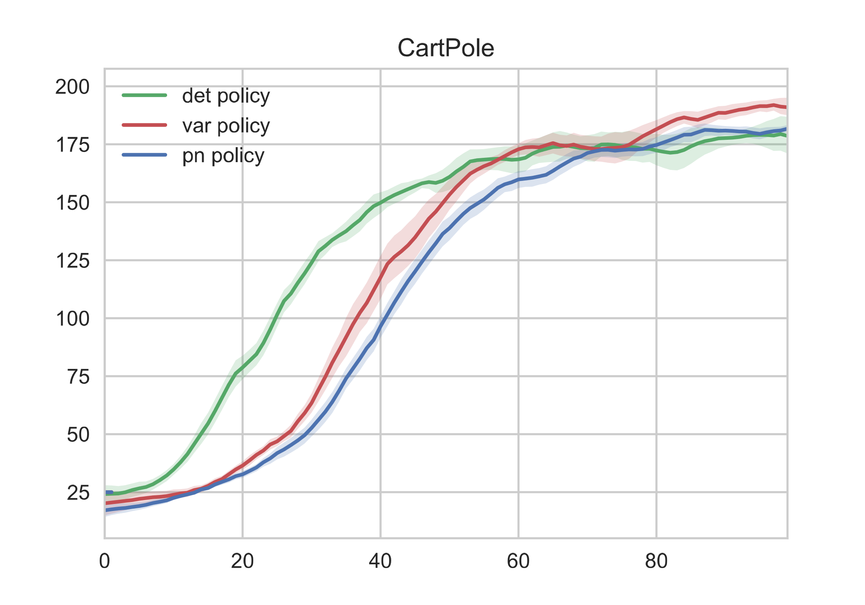
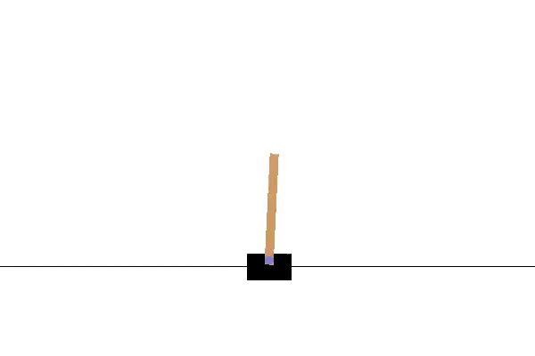
Experiments: reinforcement learning

Slide 24
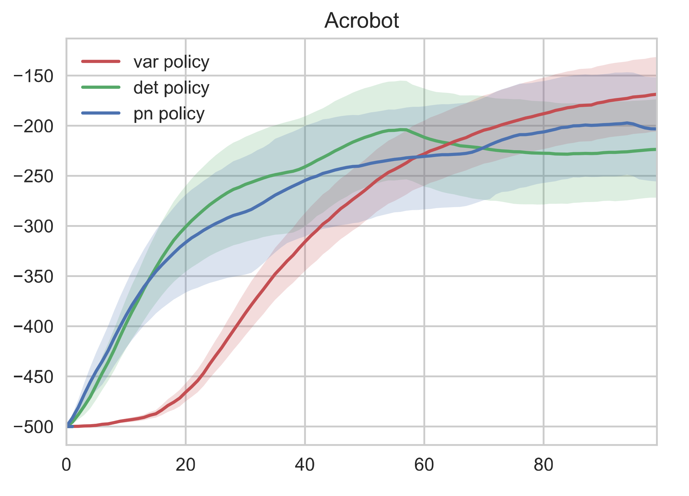
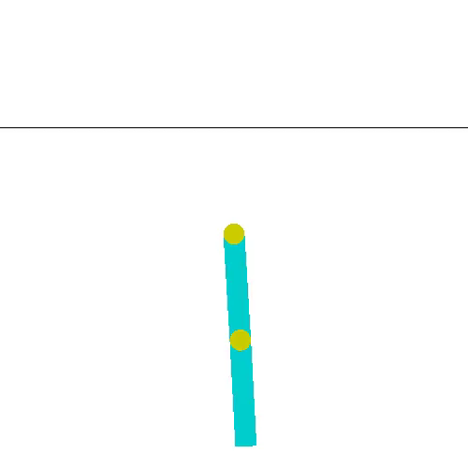
Experiments: reinforcement learning

Slide 25
Outline
Variance networks
Variational dropout ⬄ variance network
Mean propagation
Open questions

Slide 26
Mean propagation
In all conventional stochastic networks we could perform mean propagation
a.k.a. weight scaling rule
a.k.a. deterministic procedure
It fails miserably on variance networks
Why it fails and how to test whether it fails?
DNN is a highly non-linear function of its weights
Which weights can be substituted with their expectations?

Slide 27
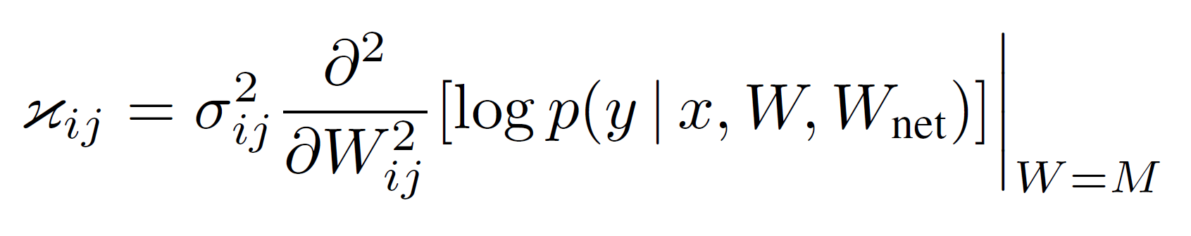
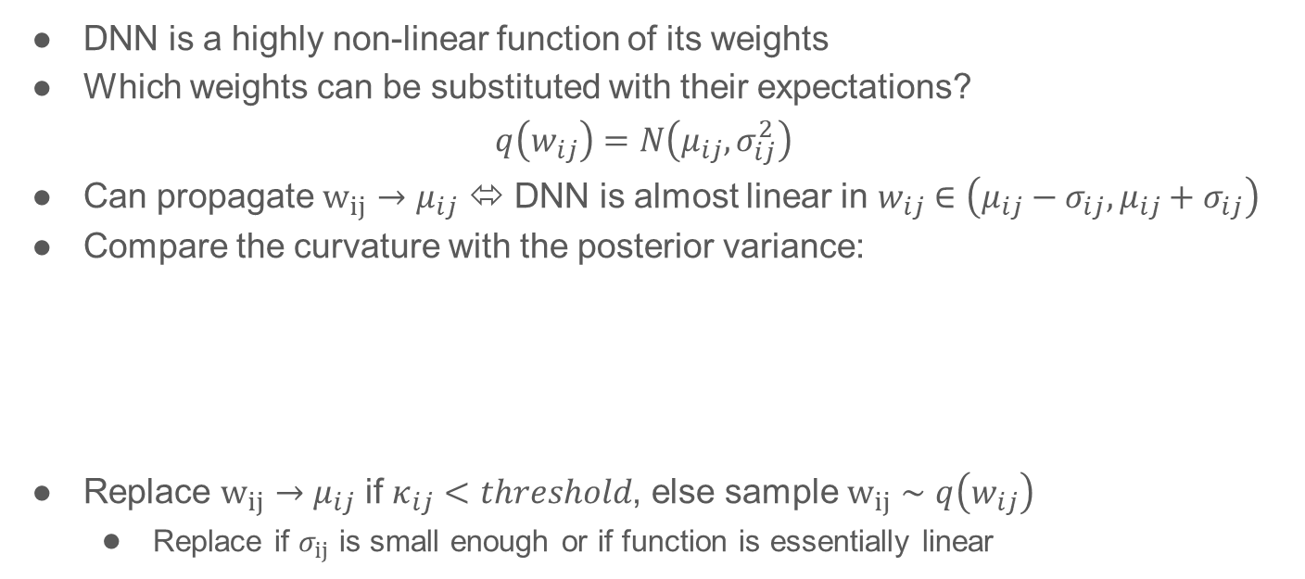
Mean propagation
DNN is a highly non-linear function of its weights
Which weights can be substituted with their expectations?
$$q\left(w_{ij}\right)=N\left(μ_{ij}, σ_{ij}^{2}\right)$$
Can propagate $w_{ij}→μ_{ij}$ ⬄ DNN is almost linear in $w_{ij}∈\left(μ_{ij}−σ_{ij}, μ_{ij}+σ_{ij}\right)$
Compare the curvature with the posterior variance:
Replace $w_{ij}→μ_{ij}$ if $κ_{ij}<threshold$, else sample $w_{ij}∼q\left(w_{ij}\right)$
Replace if $σ_{ij}$ is small enough or if function is essentially linear

Slide 28
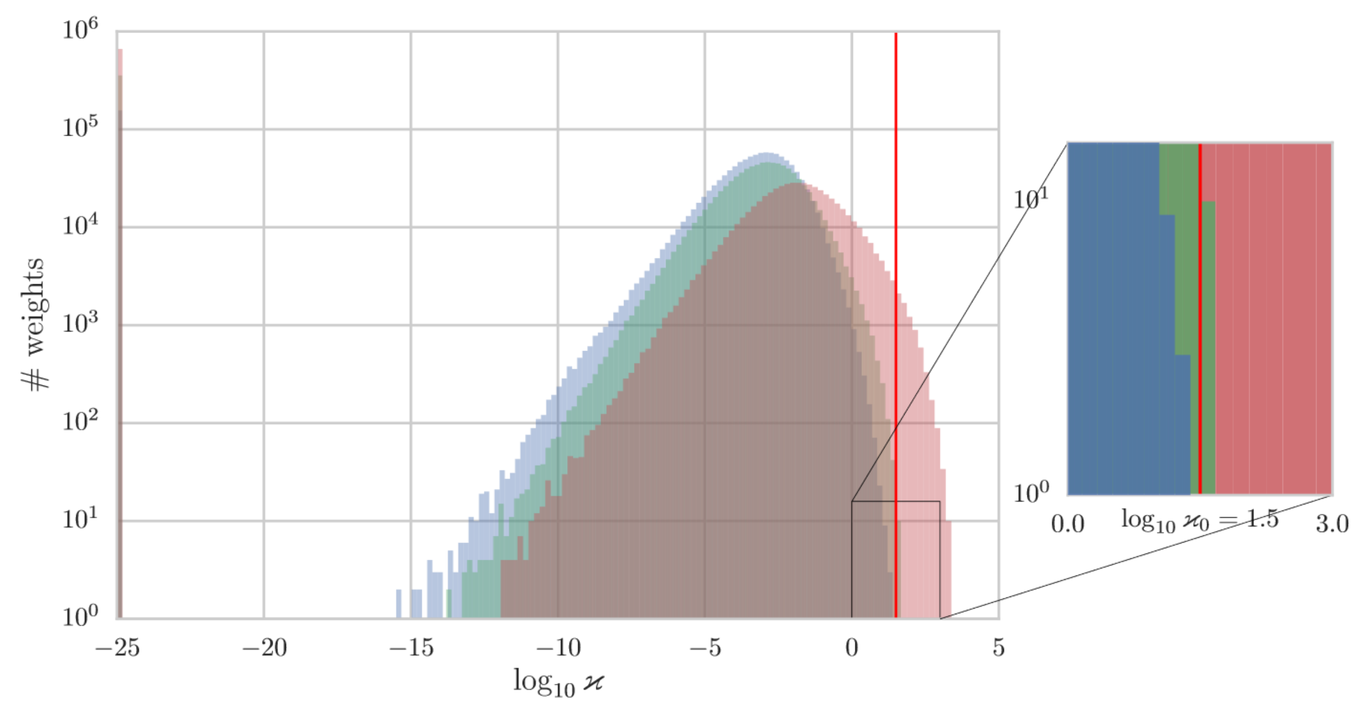
Mean propagation:

Slide 29
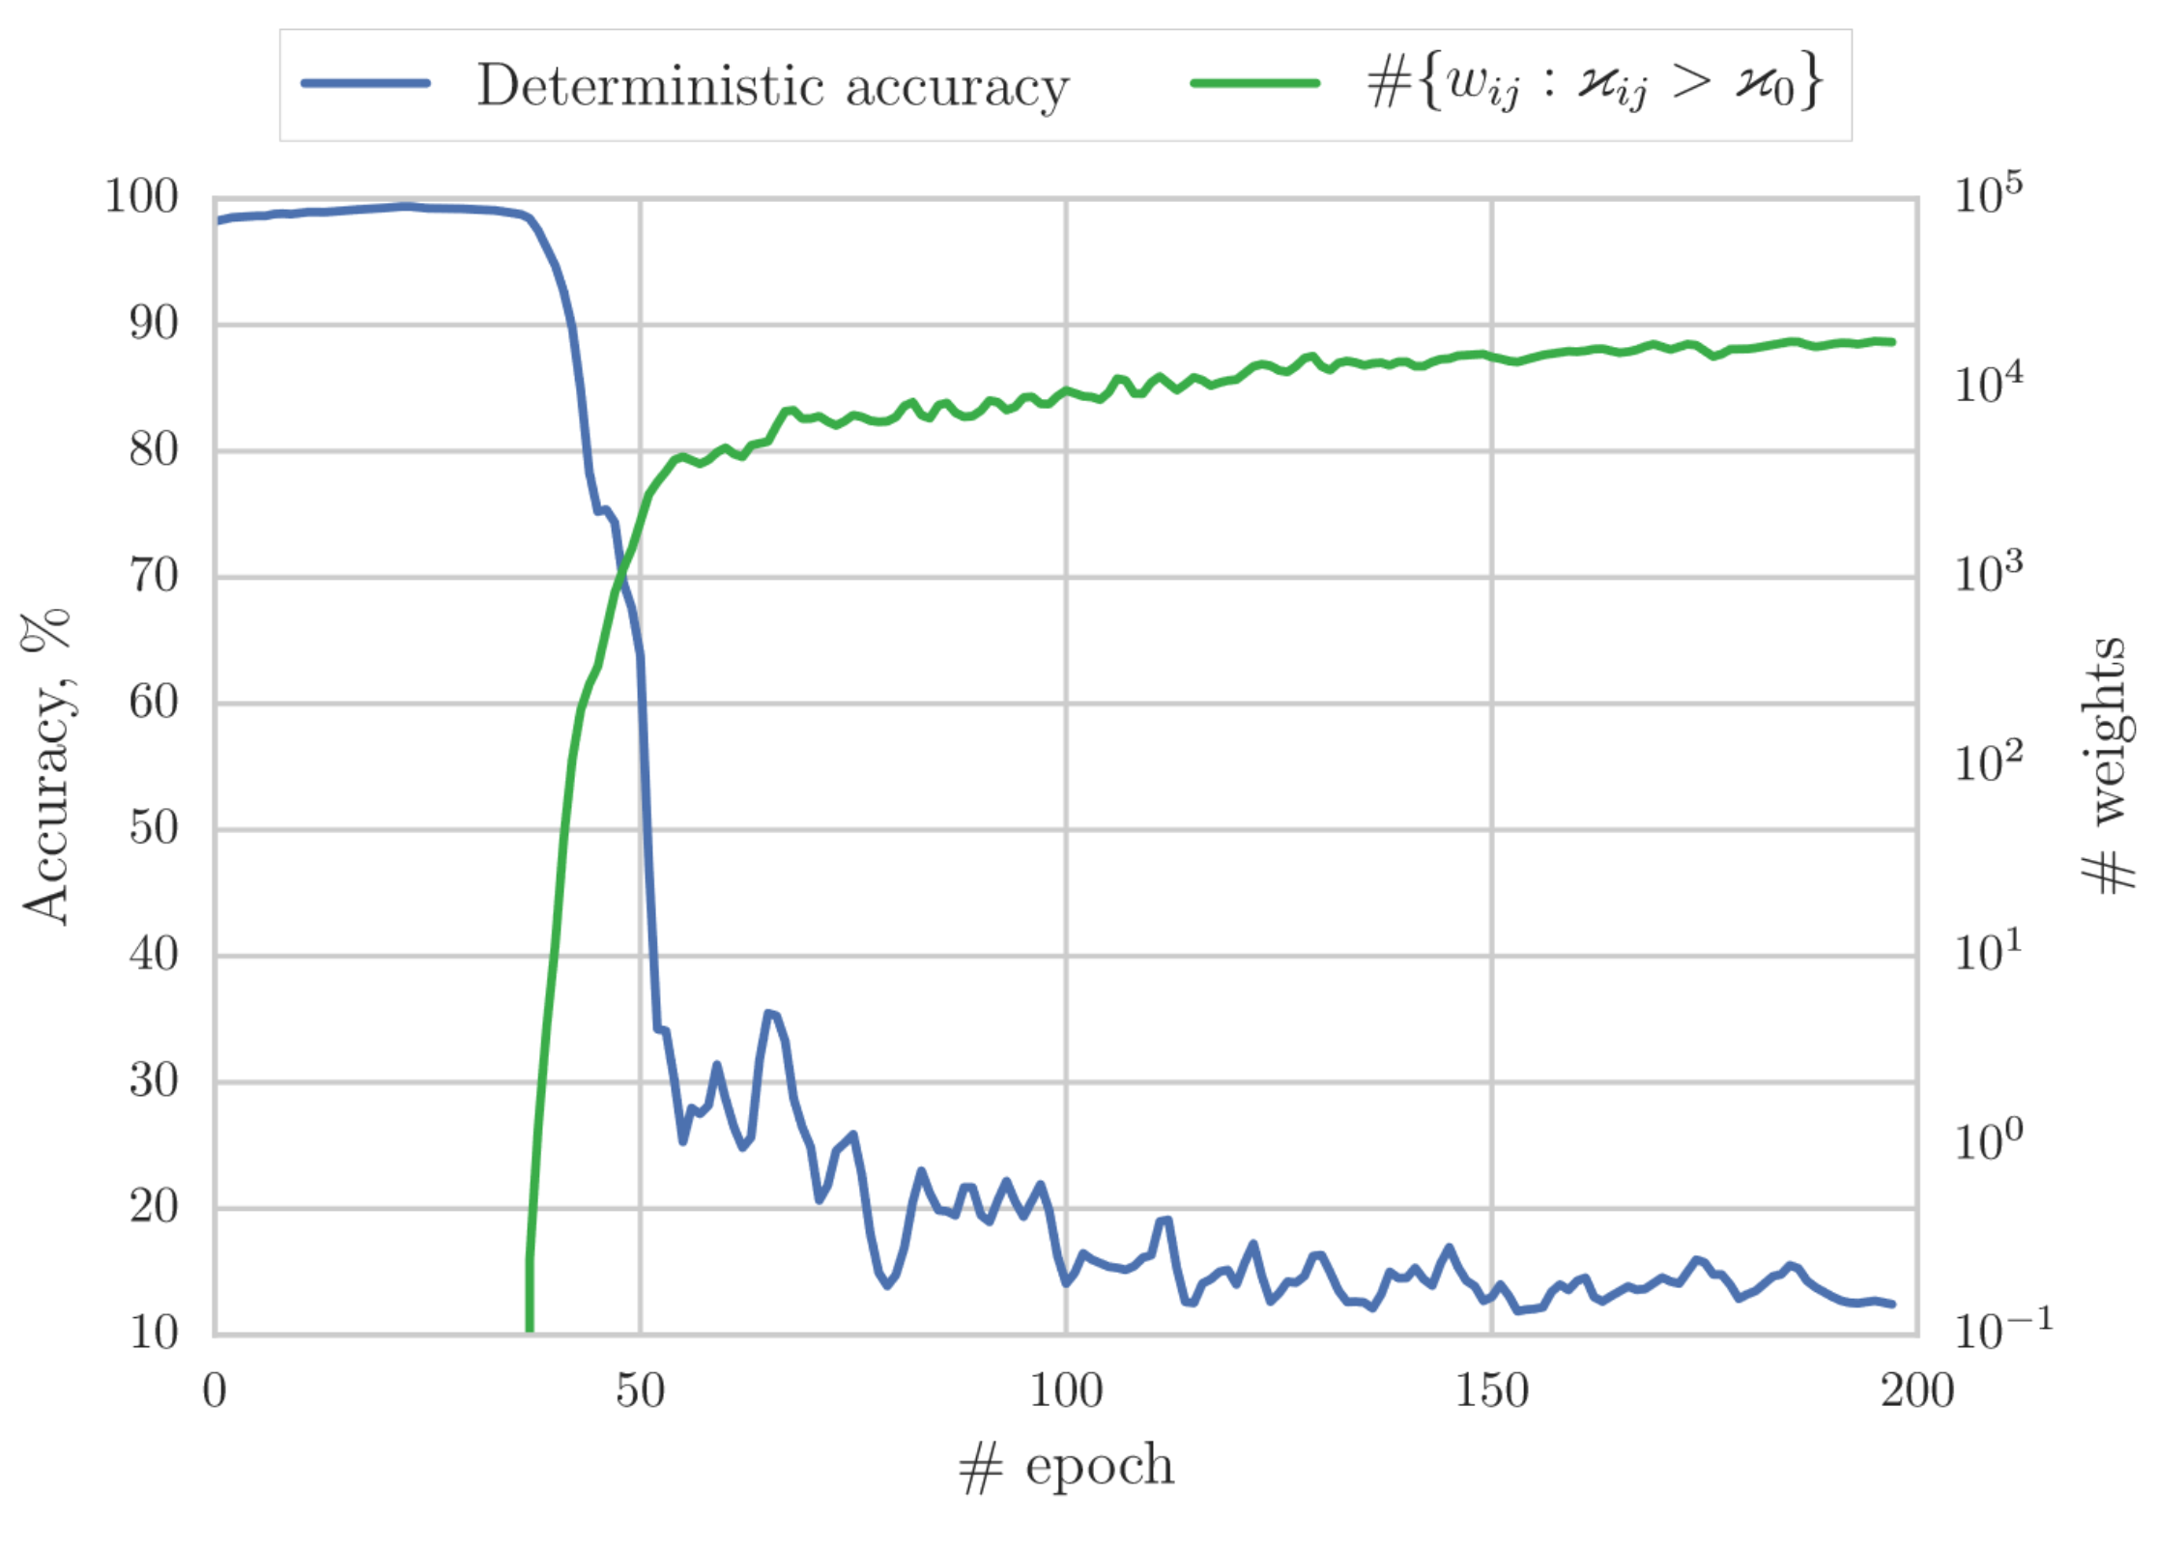
Mean propagation

Slide 30
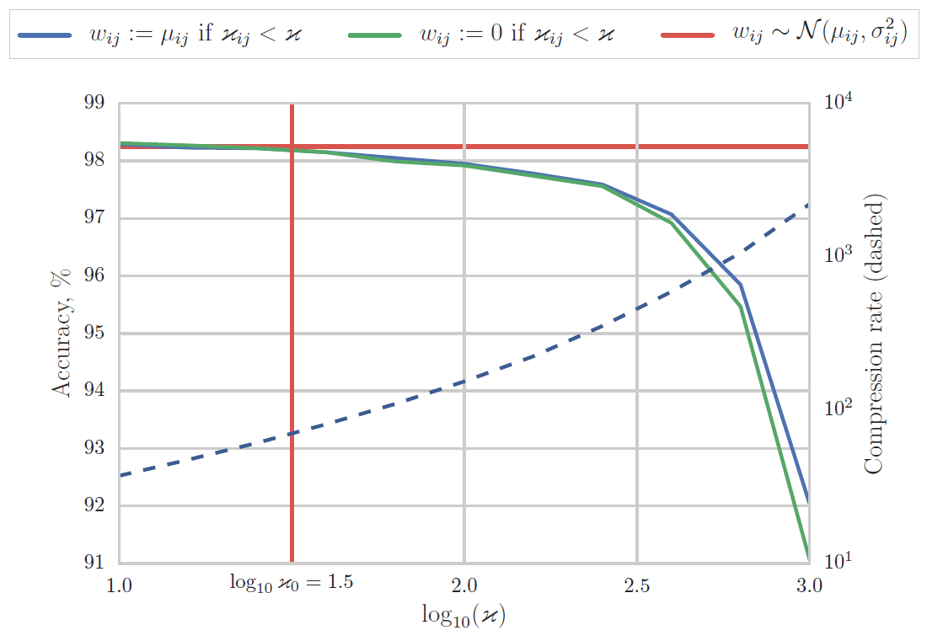
Mean propagation:
We can potentially make sigma very sparse!
Probably sparsity follows from an optimization issue ☹

Slide 31
Outline
Variance networks
Variational dropout ⬄ variance network
Mean propagation
Open questions

Slide 32
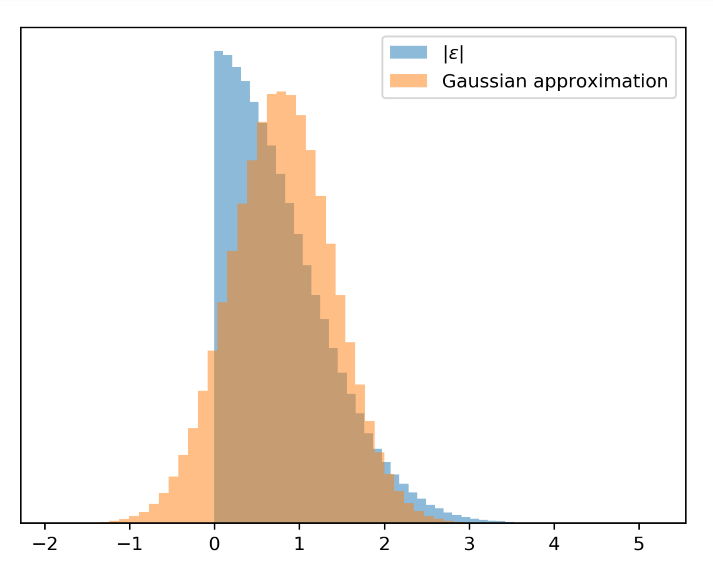
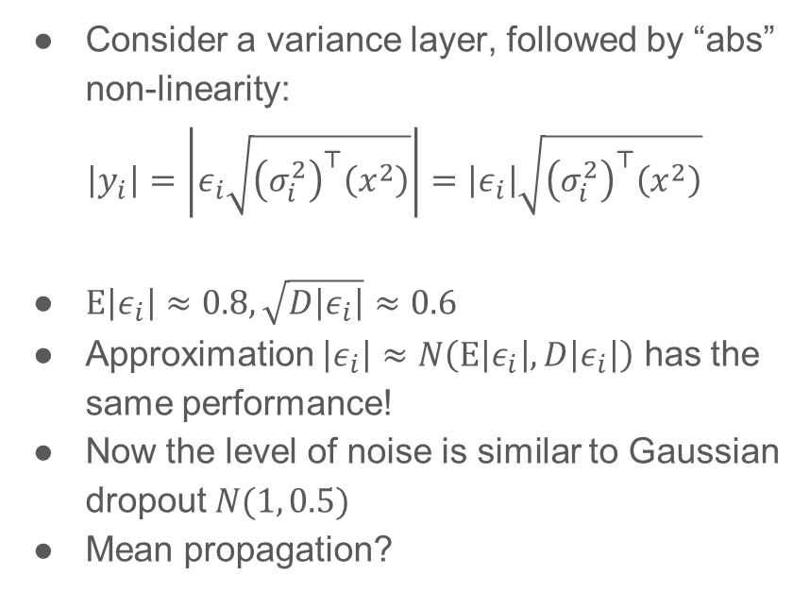
Is it really more diverse?
Consider a variance layer, followed by “abs” non-linearity:
$$\left|y_{i}\right|=\left|ε_{i}\sqrt{{\left(σ_{i}^{2}\right)}^{⊤}\left(x^{2}\right)}\right|=\left|ε_{i}\right|\sqrt{{\left(σ_{i}^{2}\right)}^{⊤}\left(x^{2}\right)}$$
$E\left|ε_{i}\right|≈0.8, \sqrt{D\left|ε_{i}\right|}≈0.6$
Approximation $\left|ε_{i}\right|≈N\left(E\left|ε_{i}\right|,D\left|ε_{i}\right|\right)$ has the same performance!
Now the level of noise is similar to Gaussian dropout $N(1, 0.5)$
Mean propagation?

Slide 33
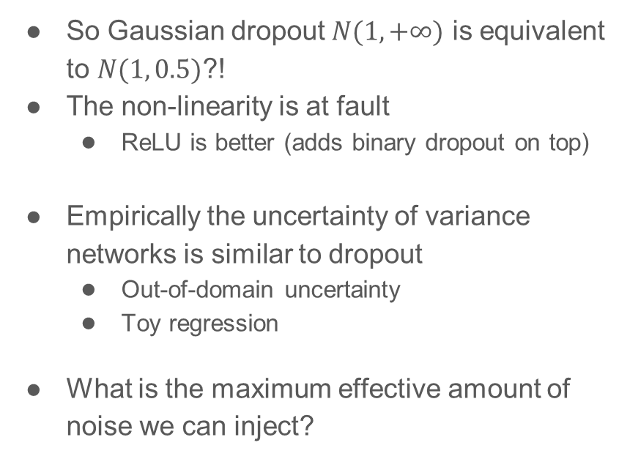
Is it really more diverse?
So Gaussian dropout $N(1, +∞)$ is equivalent to $N(1, 0.5)$?!
The non-linearity is at fault
ReLU is better (adds binary dropout on top)
Empirically the uncertainty of variance networks is similar to dropout
Out-of-domain uncertainty
Toy regression
What is the maximum effective amount of noise we can inject?

Slide 34
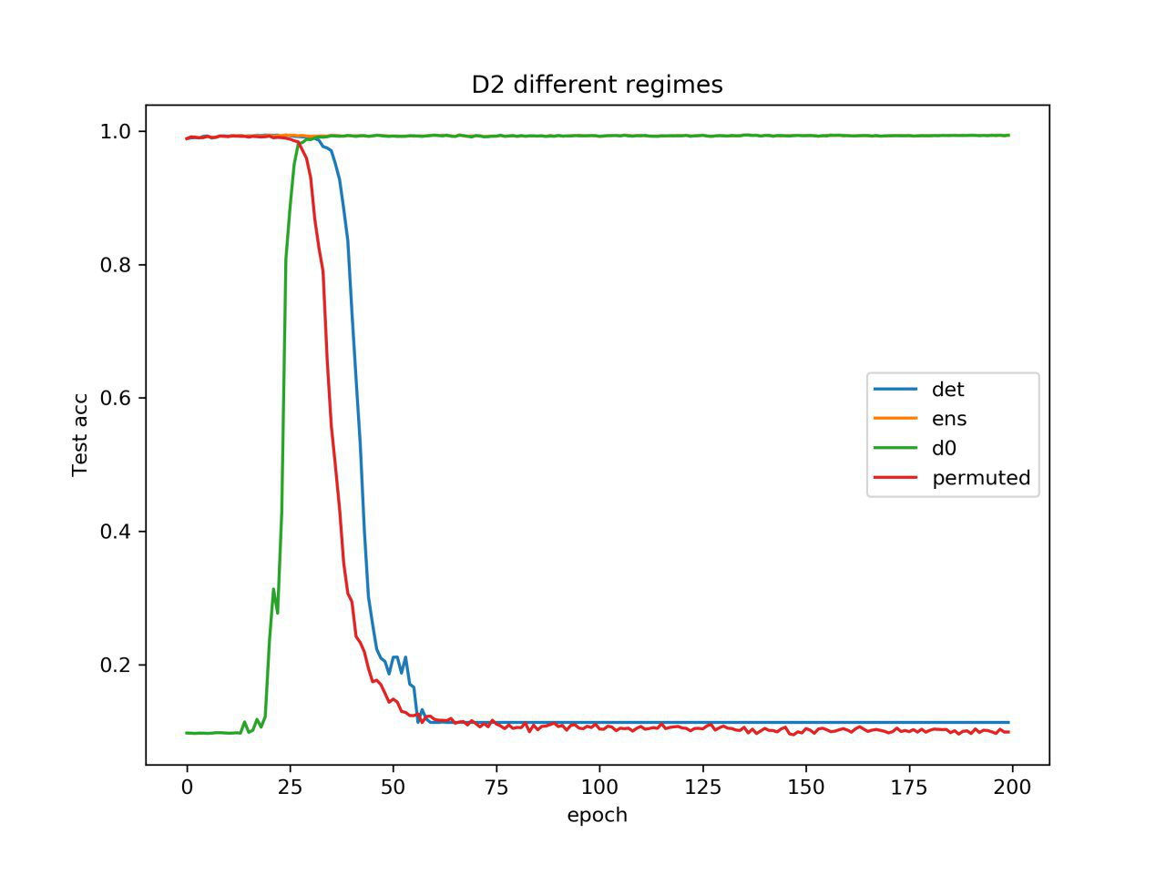
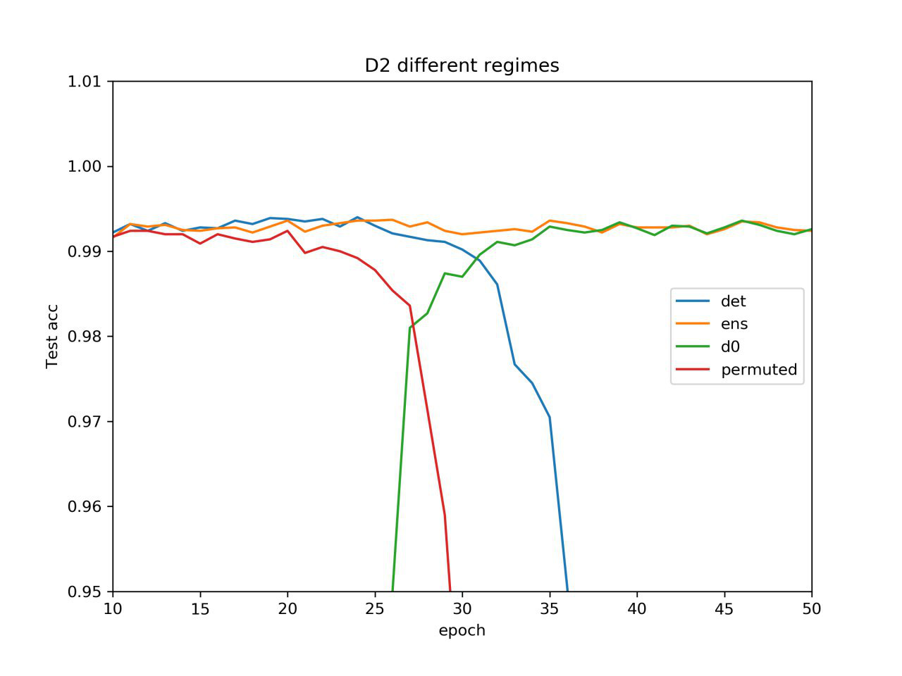
What happens during the phase transition?
Before phase transition: information in the weights
After phase transition: information in the variances
During phase transition - ???
Both mean propagation and mean zeroing work well!

Slide 35
Variance networks
A fun counter-intuitive model
First practical example where mean propagation fails that hard
Variational dropout leads to unexpected results
We probably need better ways to approximate the posterior to obtain better ensembles…
Why do we need variance networks? Are they any good? What are the implications of the DNN loss structure, robustness to noise, etc.?

